Slide 1

课时练习
模块六 第二章 第二节

Slide 2
一、翻译下列词组。
1. 在……中心 ___________________________
2. 从北到南 _____________________________
3. 对……有意义 _________________________
4. 迫不及待做某事 _______________________
in the center of …
from north to south
be meaningful to …
can’t wait to do sth.

Slide 3
一、翻译下列词组。
5. 一个半小时 ____________________/
____________________
6. 在……南部 ____________________
one hour and a half
one and a half hours
in the south of …

Slide 4
二、根据语境、音标或所给单词的提示完成句子， 每空一词。
1. China lies _______ the southwest of Japan.
2. Meizhou Bay cross-sea bridge is in __________ /ˌsaʊθ'iːst/ China’s Fujian Province.
3. They __________ /ə'naʊns/ that the flight will be delayed(航班延误).
to
southeast
announce

Slide 5
二、根据语境、音标或所给单词的提示完成句子， 每空一词。
4. Instead of rushing at life(混日子), the man wanted to do something more ____________ (mean).
5. The year 2021 was the 100th anniversary of the __________ (found) of the Communist Party of China(中国共产党).
meaningful
founding

Slide 6
三、单项选择。
( )1. Fuzhou is ______ the south of Ningde, and _______ the north of Xiamen.
A. in; on B. on; to C. in; to
B

Slide 7
三、单项选择。
( )2. —_______ is it from Chongqing to Xiamen?
—About two hours and a half by plane.
A. How long B. How far C. How often
B

Slide 8
三、单项选择。
( )3. —Russia is the world’s largest country in terms of area.
—Yes. It _______ more than 17 million square kilometers.
A. covers B. raises C. holds
A

Slide 9
三、单项选择。
( )4. Young kids always can’t wait _______, while the grown-ups dream of being young.
A. grow up B. growing up C. to grow up
C

Slide 10
三、单项选择。
( )5. —Thanks for taking me to the party. ______, can you drive me home tonight?
—No problem.
A. By the way B. In the way C. On the way
A

Slide 11
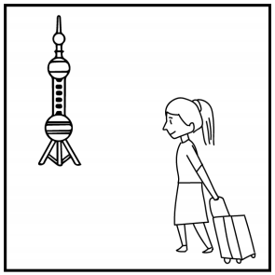
四、看图写话。
1. vacation, yesterday
The woman/She went to Shanghai for vacation yesterday.

Slide 12
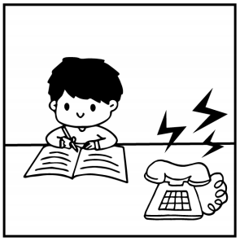
四、看图写话。
2. when
The boy/He was doing his homework when the telephone rang.

Slide 13
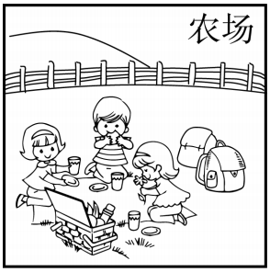
四、看图写话。
3. camp, now
The kids/They are camping on a/the farm now.

Slide 14
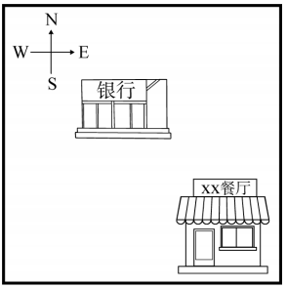
四、看图写话。
4. lie
The restaurant lies to the southeast of the bank./
The bank lies to the northwest of the restaurant.

Slide 15
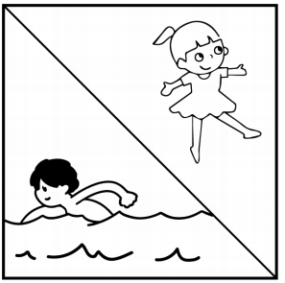
四、看图写话。
5. while
The boy is swimming while the girl is dancing.

Slide 16


